Slide 1



DC Link Capacitor Optimization for Integrated Modular Motor Drives
The 26th IEEE International Symposium on Industrial Electronics
Mesut Uğur
ugurm@metu.edu.tr
Department of Electrical and Electronics Engineering
Middle East Technical University
20/06/2017

Slide 2
Outline
Introduction (1’) => 1 slayt
IMMD Technology Review (2’) => 2 slayt
DC Link Modeling (2’) => 3 slayt
DC Link Capacitor Evaluation (2’) => 3 slayt
Results (2’) => 2 slayt
Conclusions (1’) => 1 slayt
References

Slide 3
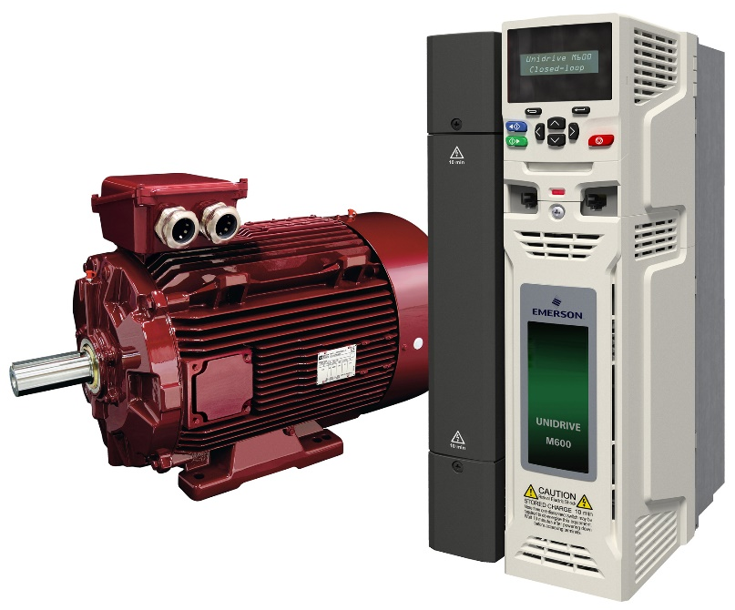
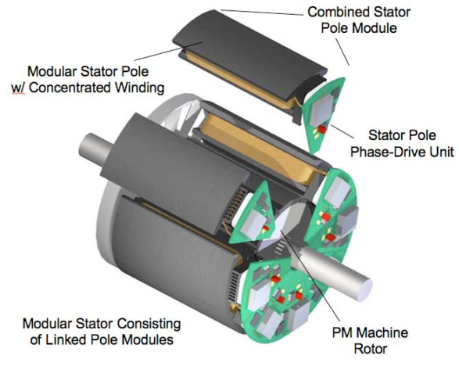
Introduction
Drives are placed in a separate cabinet
Increased volume, weight and cost
Connection with long cables
Long cable effect, EMI problems
The motor drive is integrated to the motor
Both the motor and the drive are modularized
http://www.emersonindustrial.com

Slide 4
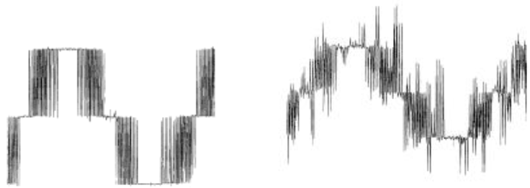
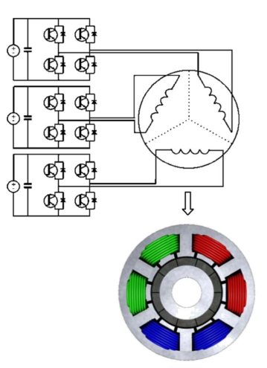
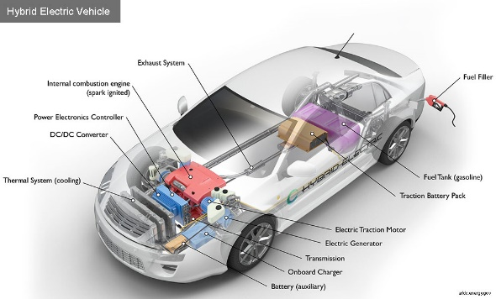
IMMD Technology Review
Motivation
Power density
Voltage overshoots
Motor lifetime
Increased fault tolerance
Distributed heat dissipation
Reduced voltage stress
Critical Applications
Electric traction: EVs, HEVs, Trains
Aerospace: Aircrafts, Space crafts
https://www.afdc.energy.gov/vehicles/how-do-hybrid-electric-cars-work

Slide 5
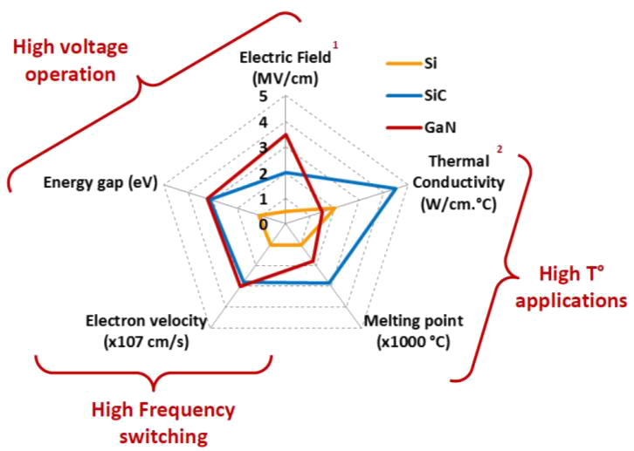
IMMD Technology Review
Challenges
Small volume ?
Cooling ?
Vibration ?
Gallium Nitride (GaN)
Wide band-gap (WBG) power semiconductor devices
Low loss: heat sink size is reduced
High speed: passive component size is reduced

Slide 6
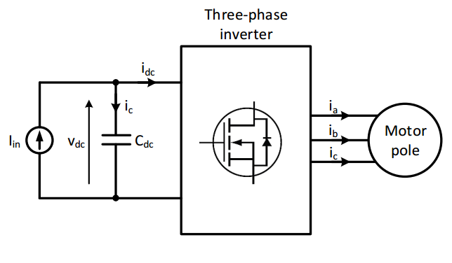
DC Link Capacitor Selection
Motivation
DC link capacitors constitute
20% of cost and weight
30% of volume
DC Link model
Critical parameters
Capacitance requirement
RMS current
Thermal characteristics
Reliability & lifetime
Mechanical durability

Slide 7
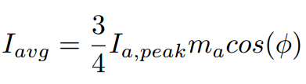
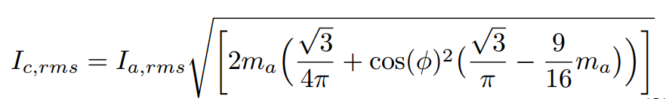
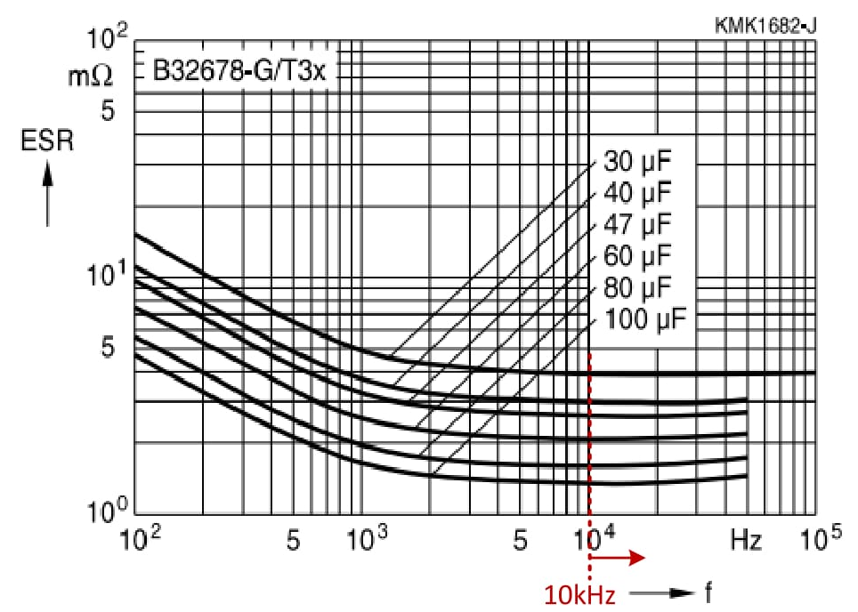

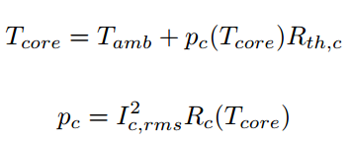
DC Link Modeling
Analytical model

Slide 8
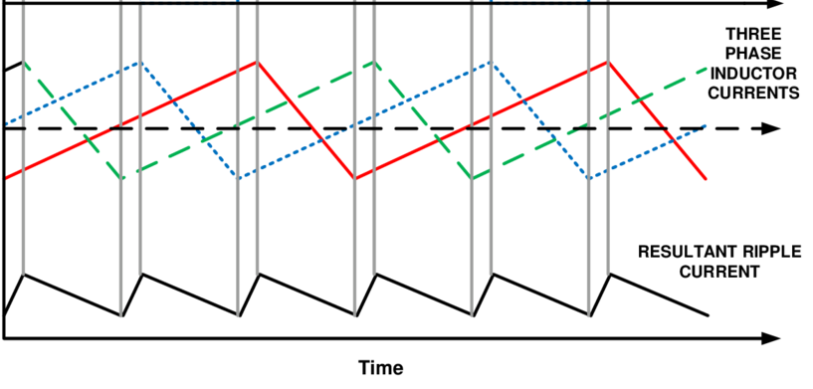
DC Link Capacitor Selection
Effect of interleaving

Slide 9
DC Link Capacitor Selection
Effect of interleaving

Slide 10
DC Link Capacitor Selection
Optimum phase shift angle for different number of modules

Slide 11
DC Link Capacitor Selection

Slide 12
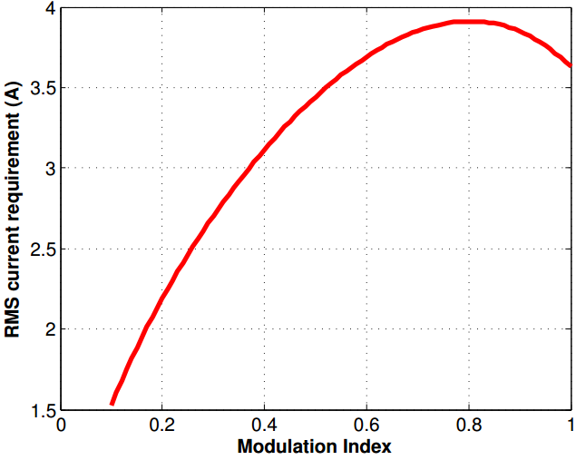
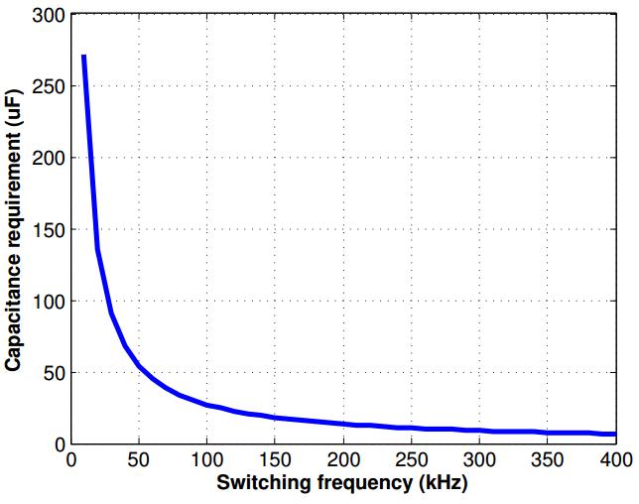
Results
RMS current vs m_{a}
Capacitance vs f_{sw}
Low voltage
Power density and cost is bad, superior thermal performance
High voltage
Low capacitance yields high cost
High capacitance yields bad thermal performance
Result:
4 25μF, 450V metal film capacitors connected in parallel

Slide 13
Conclusions
IMMD bla bla
IMMD bla bla
IMMD bla bla
IMMD bla bla
IMMD bla bla

Slide 14
References
G. Lo Calzo et al., “Integrated motor drives: state of the art and future trends,” IET Electr. Power Appl., vol. 10, no. 8, pp. 757–771, Sep. 2016.
J. Wang, Y. Li, and Y. Han, “Integrated Modular Motor Drive Design With GaN Power FETs,” IEEE Trans. Ind. Appl., vol. 51, no. c, pp. 3198–3207, 2015.
J. J. Wolmarans, M. B. Gerber, H. Polinder, S. W. H. De Haan, J. A. Ferreira, and D. Clarenbach, “A 50kW integrated fault tolerant permanent magnet machine and motor drive,” PESC Rec. - IEEE Annu. Power Electron. Spec. Conf., pp. 345–351, 2008.
N. R. Brown, T. M. Jahns, and R. D. Lorenz, “Power Converter Design for an Integrated Modular Motor Drive,” Ind. Appl. Conf. 2007. 42nd IAS Annu. Meet. Conf. Rec. 2007 IEEE, pp. 1322–1328, 2007.
S. M. Lambert, B. C. Mecrow, R. Abebe, G. Vakil, and C. M. Johnson, “Integrated Drives for Transport - A Review of the Enabling Electronics Technology,” IEEE Veh. Power Propuls. Conf., pp. 1–6, 2015.
A. Shea and T. M. Jahns, “Hardware integration for an integrated modular motor drive including distributed control,” in 2014 IEEE Energy Conversion Congress and Exposition (ECCE), 2014, pp. 4881–4887.

Slide 15


Thank you !
Mesut Uğur
ugurm@metu.edu.tr
Department of Electrical and Electronics Engineering
Middle East Technical University

